Slide 1
About the RCN Version of House Hacker
https://rcn.househackerpro.com
House Hacker Pro is a Due Diligence Tool for Single Family Residential Rehab Projects.
It helps Customers create a rehab scope of work and budget.
It is fully branded with RCN colors and logos.
RCN has a unique Landing Page for new and returning Customers.
Notes:
Due Diligence Tool for Single Family Residential Rehab Projects (Repairs & Risk)
Sales Pitch (Help customers do a better job of creating a Rehab Budget & Scope of Work)
RCN Branding
Landing Page URL (Unassigned Leads from Website)

Slide 2
RCN Account Types
(15) Loan Officer Admin Accounts
Unlimited Customer Accounts
(1) “SuperAdmin” Account

Slide 3
RCA Admin# | Loan Officer | Processor | Registration Link for Customers & for Internal Admin Account Setup
RCN1 | Matt Ferrigno | Joe Bordonaro | https://househackerpro.com/v1/link/8c7de32b-2828-4232-b27d-b560f5b6c44b
RCN2 | Kim Davis | Joe Bordonaro | http://househackerpro.com/v1/link/c49fb9d2-2a4c-4fca-92d0-f8a84a16a251
RCN3 | Chris Dorin | Sabrina Morrett | http://househackerpro.com/v1/link/5513754c-3c23-465a-8c6f-005b135fe94b
RCN4 | George Ross | Sabrina Morrett | http://househackerpro.com/v1/link/b0f63dc9-782a-4e69-bd3d-0488be6c72b6
RCN5 | Alan Johnson | Sabrina Morrett | http://househackerpro.com/v1/link/b6a7bb16-d4e0-47a1-a086-160d8dff9069
RCN6 | Jeff Mallas | Devin Lee | http://househackerpro.com/v1/link/3a7c5505-2e0b-4cce-97f6-91f16e106959
RCN7 | Eileen Mazza | Devin Lee | http://househackerpro.com/v1/link/8b1c8167-540b-48cd-80a2-fc992509035a
RCN8 | Alex Crivelli | Steve Gonzalez | http://househackerpro.com/v1/link/6bbcb2af-72cb-49c7-b98a-83e2c239f934
RCN9 | Tiffany Walker | Steve Gonzalez | http://househackerpro.com/v1/link/5e44537a-44ad-40db-9e1b-89b37b3a08d9
RCN0 | Steve Ballard* | N/A | http://househackerpro.com/v1/link/24b40709-79a0-4922-a96d-43d768aae80d
Loan Processor | Various | Joe, Sabrina, Devin, Steve | https://househackerpro.com/v1/link/84be367a-c33a-4251-9e0d-2e1b066d4f8a

Slide 4
Setting up Admin Accounts
Use the same link that you will be given to send out to customers to create an account
House Hacker will convert your account to have Admin privileges
Notes:
Setting up Customer Accounts
Sending your unique link to Customers
Customer account creation process

Slide 5
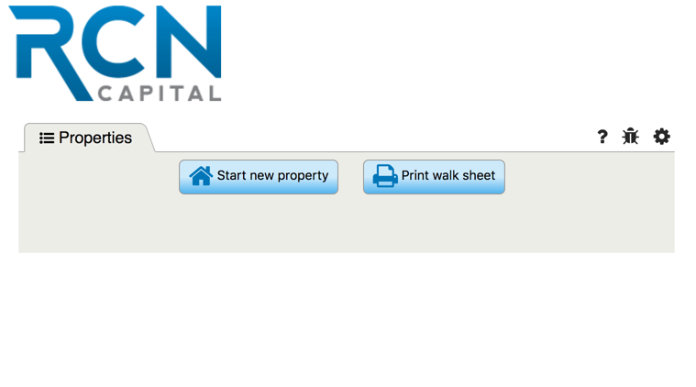
Setting up Customer Accounts
Sending your unique link to Customers
Customer account creation process
Consider embedding your unique link in you email signature
ONLY send out the original link, do NOT copy the webpage url
Notes:
Setting up Customer Accounts
Sending your unique link to Customers
Customer account creation process

Slide 6
Email Signature Option for Link Distribution
Jeffrey Tesch Managing Director
P \ 860.432.5858 x1301
RCN Capital is excited to introduce a streamlined approval process, allowing us to issue commitment letters in as little as 48 hours! To learn more, click here.
75 Gerber Rd East
South Windsor, CT 06074
RCNCapital.com

Slide 7
RCN Login Page for Customers & Admins
https://rcn.househackerpro.com

Slide 8
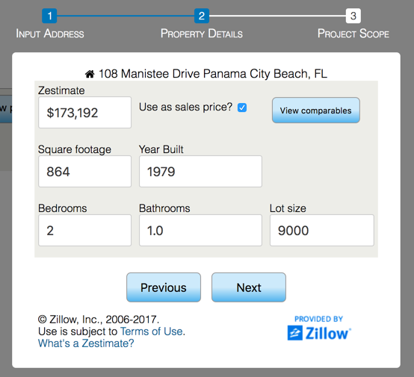
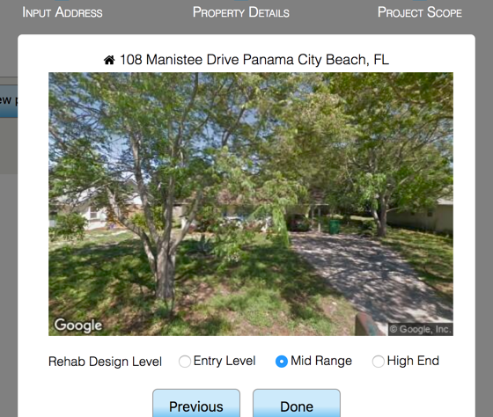
Starting a Record 3 Step Process
Address
Square Footage
Design Level
Notes:
Starting a Record 3 Step Process
Address
Square Footage
Design Level

Slide 9
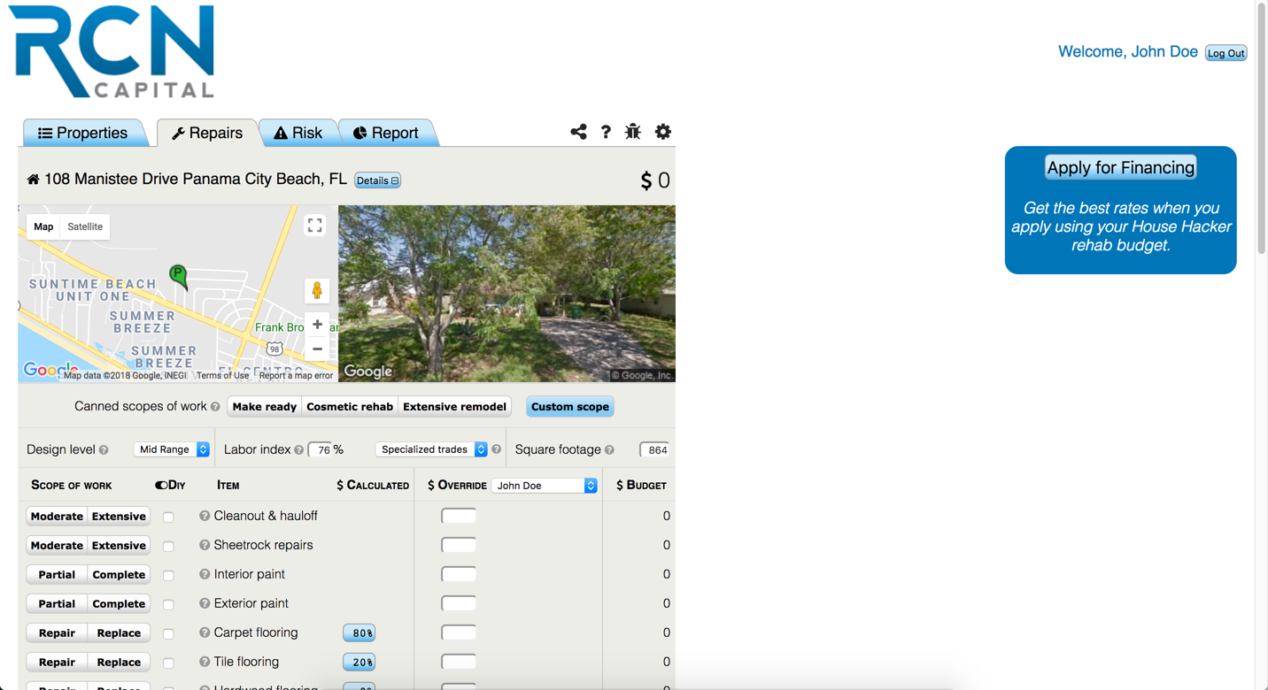
Repair Estimate Landing Page
This is what the Customer will see once they complete the 3-step property set-up phase.

Slide 10
Property Settings Header

Slide 11
Property Settings Header
Design Level
Labor Index
Labor Type
Square Footage
Notes:
Property Settings Header
Design Level
Labor Index
Labor Type
Square Footage

Slide 12
Property Settings Header
Design Level
Entry Level
Mid Range
High End
The Design Level is the Finish Out that best describes the expected quality level of the future rehab project.
Notes:
Property Settings Header
Design Level
Labor Index
Labor Type
Square Footage

Slide 13
Property Settings Header
Labor Index
This number comes from a regional labor index that adjusts at the zip code level. It cannot be manually overridden.
Notes:
Property Settings Header
Design Level
Labor Index
Labor Type
Square Footage

Slide 14
Property Settings Header
Labor Type
Specialized Trades
General Labor
Specialized Trades are companies that perform one main function.
General Labor is the Handyman or Crew Model using unlicensed or unskilled laborer's.
Notes:
Property Settings Header
Design Level
Labor Index
Labor Type
Square Footage

Slide 15
Property Settings Header
Square Footage
This comes from the Zillow database. It can be input manually if Zillow does not have that data or if the Zillow data is incorrect.
Notes:
Property Settings Header
Design Level
Labor Index
Labor Type
Square Footage

Slide 16
Repair Tab Page Navigation

Slide 17
Repair Tab Page Navigation
Canned Scopes of Work
Details (GUI Collapse)
Tooltips
Apply for Financing
Notes:
Page Navigation
Canned Scope of Work
Details Collapse
Tooltips
Logout
Apply for Financing
Save Button

Slide 18
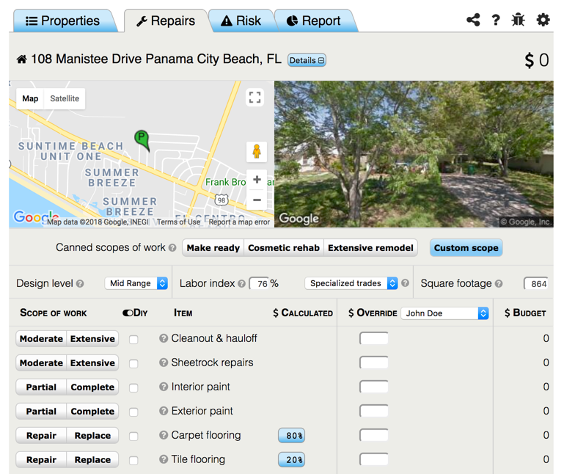
Repair Tab Page Navigation
Canned Scopes of Work
Use these pre-selected scopes of work to make the data entry process even faster. You can modify any of the selections as needed after selecting one of them.
Notes:
Page Navigation
Canned Scope of Work
Details Collapse
Tooltips
Logout
Apply for Financing
Save Button

Slide 19
Repair Tab Page Navigation
Details Collapse
Collapse the Google Map and Street view to reduce clutter and screen space.
Notes:
Page Navigation
Canned Scope of Work
Details Collapse
Tooltips
Logout
Apply for Financing
Save Button

Slide 20
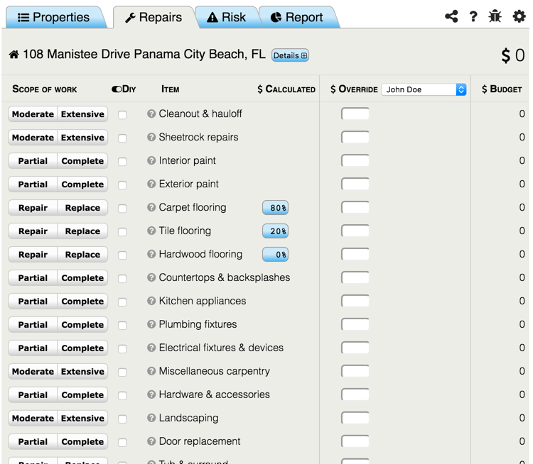
Repair Tab Page Navigation
Details Collapse
Collapse the Google Map and Street view to reduce clutter and screen space.
Notes:
Page Navigation
Canned Scope of Work
Details Collapse
Tooltips
Logout
Apply for Financing
Save Button

Slide 21
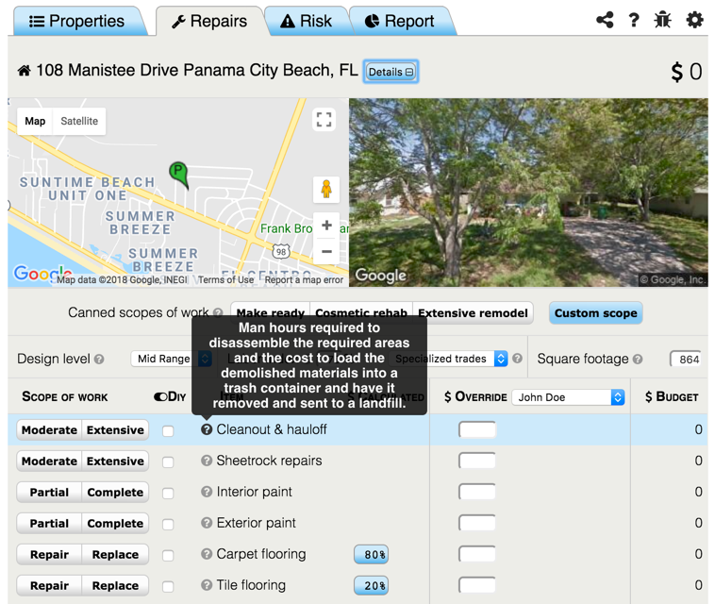
Repair Tab Page Navigation
Tooltips
Hover over the dots with the question marks to get additional information about features and functions.
Notes:
Page Navigation
Canned Scope of Work
Details Collapse
Tooltips
Logout
Apply for Financing
Save Button

Slide 22
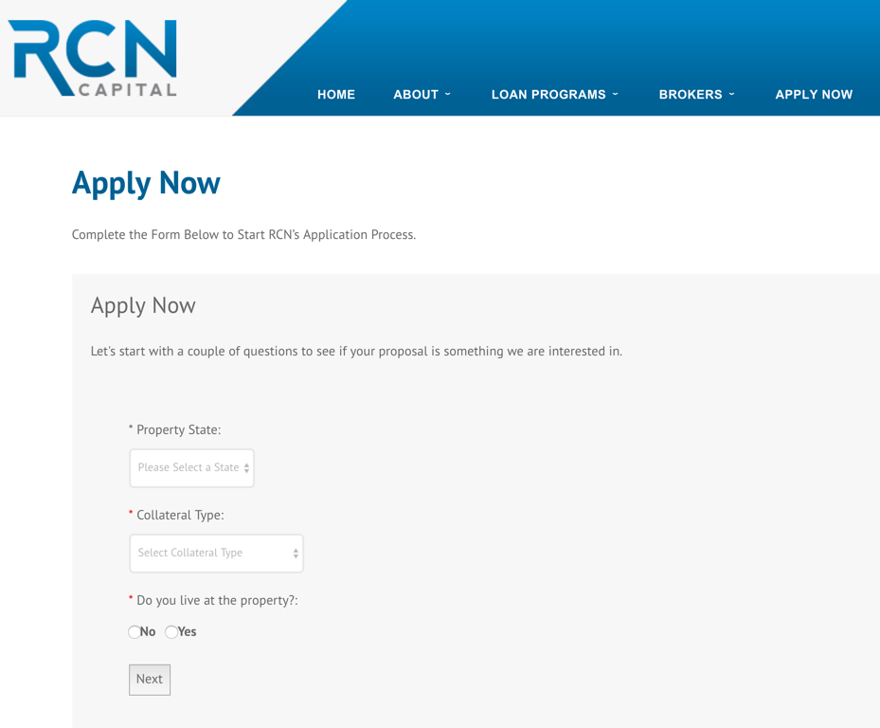
Repair Tab Page Navigation
Apply for Financing
This will send users to the RCN Loan Application Webpage to apply for financing for their rehab project.
Notes:
Page Navigation
Canned Scope of Work
Details Collapse
Tooltips
Logout
Apply for Financing
Save Button

Slide 23
Repair Cost Modifiers

Slide 24
Repair Cost Modifiers
Scope Intensity Selections
Override Fields
DIY (Do It Yourself) Button
Notes:
Repair Cost Modifiers
Labor Type and Intensity
Intensity Buttons
Override Fields
DIY (Labor Only)

Slide 25
Repair Cost Modifiers
Scope Intensity Selections
These are paired as Moderate-Extensive, Partial-Complete and Repair-Replace. Select the scope of work that best describes what’s going to be done during the future rehab project.
Notes:
Repair Cost Modifiers
Labor Type and Intensity
Intensity Buttons
Override Fields
DIY (Labor Only)

Slide 26
Repair Cost Modifiers
Override Fields
Any calculated value can be overridden with a custom value, however, the scope selection must be made in order for the user to enter a value.
Notes:
Repair Cost Modifiers
Labor Type and Intensity
Intensity Buttons
Override Fields
DIY (Labor Only)

Slide 27
Repair Cost Modifiers
DIY Selections
Checking the DIY box will remove the labor allowance from the repair budget for that line item. This is helpful for borrowers that are going to self-perform some parts of the rehab.
Notes:
Repair Cost Modifiers
Labor Type and Intensity
Intensity Buttons
Override Fields
DIY (Labor Only)

Slide 28
Using Scope Selection Buttons

Slide 29
Using Scope Selection Buttons
Flooring Selections
Adding Custom Scenarios
Manual Categories
Indirect Costs
Notes:
Using Selection Buttons (4 Main Types)
Flooring Selections
Adding Custom Scenarios
Calculated Rows (Add-on*, Fence, Patio)
Indirect Costs

Slide 30
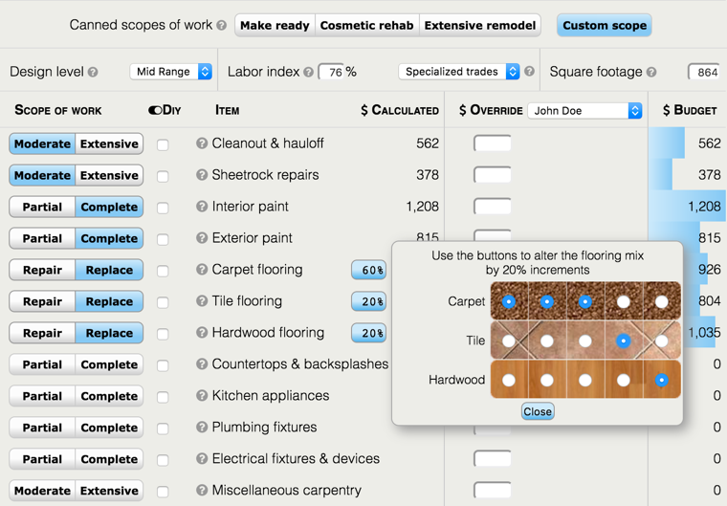
Using Scope Selection Buttons
Flooring Selections
You can select from 3 flooring types; Carpet, Tile and Hardwood, using 20% increments by selecting this approximate coverage amount using the graphic user interface.
Notes:
Using Selection Buttons (4 Main Types)
Flooring Selections
Adding Custom Scenarios
Calculated Rows (Add-on*, Fence, Patio)
Indirect Costs

Slide 31
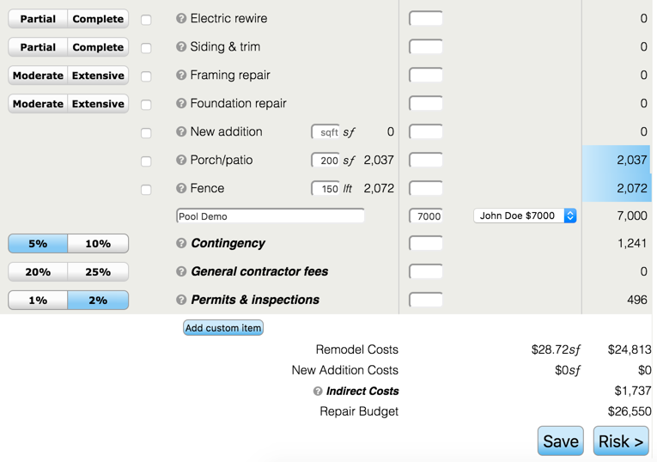
Using Scope Selection Buttons
Adding Custom Scenarios
If you need additional repair categories that are not in the standard list you can click the “Add Custom Item” button to add as many categories as you would like.
Notes:
Using Selection Buttons (4 Main Types)
Flooring Selections
Adding Custom Scenarios
Calculated Rows (Add-on*, Fence, Patio)
Indirect Costs

Slide 32
Using Scope Selection Buttons
Manual Categories
There are 3 Repair Categories that require manual data entry to calculate accurately; New Addition, Porch/Patio and Fence. Enter the required quantity as called for.
Notes:
Using Selection Buttons (4 Main Types)
Flooring Selections
Adding Custom Scenarios
Calculated Rows (Add-on*, Fence, Patio)
Indirect Costs

Slide 33
Using Scope Selection Buttons
Indirect Costs
These are costs that are not direct construction costs. They are the overhead and cost of doing business associated with a rehab project.
Notes:
Using Selection Buttons (4 Main Types)
Flooring Selections
Adding Custom Scenarios
Calculated Rows (Add-on*, Fence, Patio)
Indirect Costs

Slide 34
Header Navigation - Toolbar

Slide 35
Header Navigation Toolbar
Sharing
Help
Bug Reporting
Settings
Notes:
Header Navigation - Settings
Sharing
Help
Bug Reports
Settings

Slide 36
Header Navigation Toolbar
Sharing
Records can be shared with other people via text or email. A link to the property report will be sent to the designated person.
Notes:
Header Navigation - Settings
Sharing
Help
Bug Reports
Settings

Slide 37
Header Navigation Toolbar
Help
Here you can find FAQ page with answers to common questions and additional information about House Hacker.
Notes:
Header Navigation - Settings
Sharing
Help
Bug Reports
Settings

Slide 38
Header Navigation Toolbar
Bug Reporting
If you find a bug, please click the Bug Icon and fill out a brief description of the problem you are having. This will send valuable information to help resolve issues.
Notes:
Header Navigation - Settings
Sharing
Help
Bug Reports
Settings

Slide 39
Header Navigation Toolbar
Settings
Here you can find information about your profile and account details.
Notes:
Header Navigation - Settings
Sharing
Help
Bug Reports
Settings

Slide 40
Header Navigation - Tabs

Slide 41
Header Navigation Tabs
Repairs
Risk
Report
Notes:
Header Navigation - Tabs
Repairs
Risk
Report

Slide 42
Header Navigation - Tabs
Repairs
Create your repair scope of work and budget here.
Notes:
Header Navigation - Tabs
Repairs
Risk
Report

Slide 43
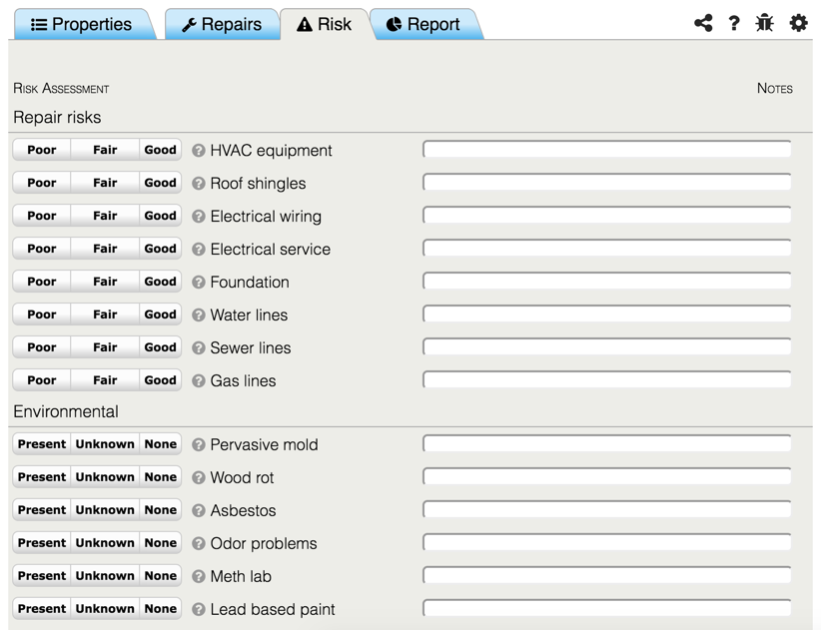
Header Navigation - Tabs
Risk
Go through this handy checklist of common deal killers to make sure the you don’t overlook a major problem.
Notes:
Header Navigation - Tabs
Repairs
Risk
Report

Slide 44
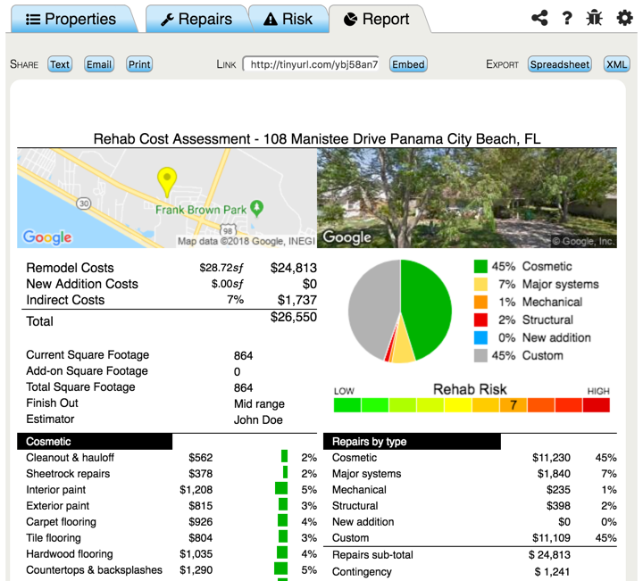
Header Navigation - Tabs
Report
This beautiful report is comprehensive and easy to read and can easily be shared with other stakeholders.
Notes:
Header Navigation - Tabs
Repairs
Risk
Report

Slide 45
Property Record Landing Page

Slide 46
Property Record Landing Page
This is what the Admins will see on their list of properties created by their Borrowers.

Slide 47
Property Record Landing Page
Sorting
Searching
Mapping Properties
Navigation Shortcuts
Property Status Types
Deleting Properties
Printing the Walk Sheet
Notes:
The Properties Landing Page
Sorting
Searching
Mapping
Page Navigation
Printing the Walksheet
Property Status Types (Prospect, Closed, Funded, Inactive)
Deleting Properties

Slide 48
Property Record Landing Page
Sorting
All columns can be sorted in alphabetical or numeric order by clicking on the column header to help find or organize your data.
Notes:
The Properties Landing Page
Sorting
Searching
Mapping
Page Navigation
Printing the Walksheet
Property Status Types (Prospect, Closed, Funded, Inactive)
Deleting Properties

Slide 49
Property Record Landing Page
Searching
Use the search box as a quick way to find information when your database starts to grow.
Notes:
The Properties Landing Page
Sorting
Searching
Mapping
Page Navigation
Printing the Walksheet
Property Status Types (Prospect, Closed, Funded, Inactive)
Deleting Properties

Slide 50
Property Record Landing Page
Mapping Properties
Use the mapping feature to see your rehab projects displayed on a map. Filter your results with the drop down lists at the top of the page.

Slide 51
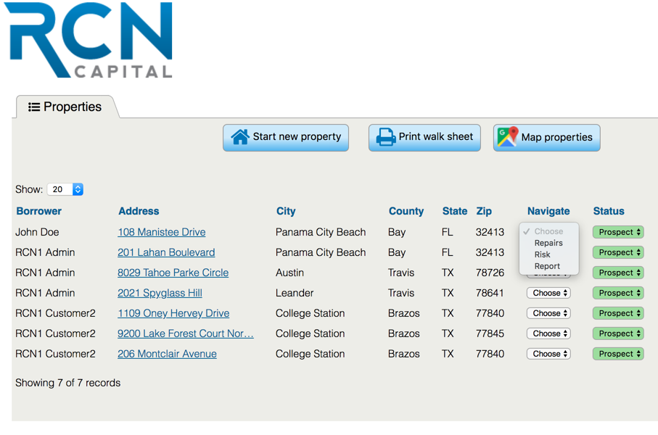
Property Record Landing Page
Navigation Shortcuts
These are a handy way to quickly jump to the exact page that you are looking for. Select the Repair, Risk or Report Tabs to jump to.
Notes:
The Properties Landing Page
Sorting
Searching
Mapping
Page Navigation
Printing the Walksheet
Property Status Types (Prospect, Closed, Funded, Inactive)
Deleting Properties

Slide 52
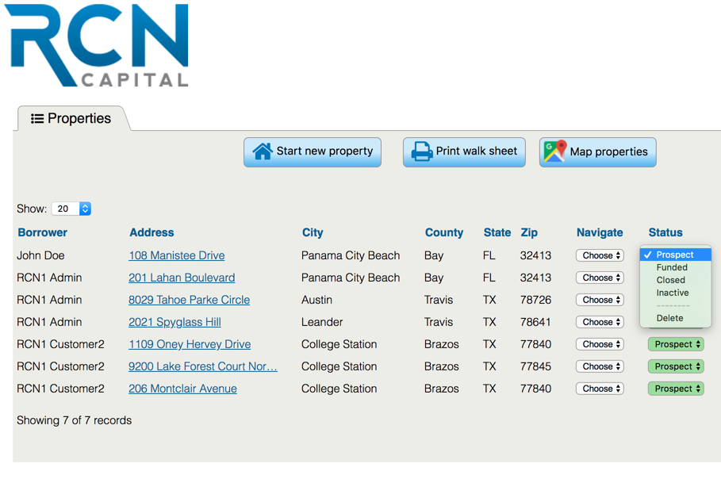
Property Record Landing Page
Property Status Types
These Statuses (Prospect, Funded, Closed, Inactive) can be used to organize your property records.
Notes:
The Properties Landing Page
Sorting
Searching
Mapping
Page Navigation
Printing the Walksheet
Property Status Types (Prospect, Closed, Funded, Inactive)
Deleting Properties

Slide 53
Property Record Landing Page
Deleting Properties
The Delete option at the bottom of the Status drop down list can be used to remove unwanted records.
Notes:
The Properties Landing Page
Sorting
Searching
Mapping
Page Navigation
Printing the Walksheet
Property Status Types (Prospect, Closed, Funded, Inactive)
Deleting Properties

Slide 54
Property Record Landing Page
Printing the Walk Sheet
The Walk Sheet is designed for people that do not have mobile internet or that prefer a paper checklist to take with them when they are walking houses.

Slide 55
Managing Customer Records
Notes:
MANAGING CUSTOMER RECORDS
Viewing Customer Records
Finding Customer Records (Searching and Filtering)
Editing (Locking & Unlocking)
Collaboration Scenarios (Adding and Selecting)
Sharing Records (Emailing & Texting)
Exporting to Excel

Slide 56
Managing Customer Records
Finding & Viewing Records
Editing Customer Records
Collaboration Scenarios
Exporting to Excel
Notes:
Viewing Customer Records
Finding Customer Records (Searching and Filtering)
Editing (Locking & Unlocking)
Collaboration Scenarios (Adding and Selecting)
Sharing Records (Emailing & Texting)
Exporting to Excel

Slide 57
Managing Customer Records
Finding & Viewing Records
The Admin can see the name of the Borrower that created the record in the far left column. Clicking the address hyperlink or navigation button will open the record to view or edit.
Notes:
Viewing Customer Records
Finding Customer Records (Searching and Filtering)
Editing (Locking & Unlocking)
Collaboration Scenarios (Adding and Selecting)
Sharing Records (Emailing & Texting)
Exporting to Excel

Slide 58
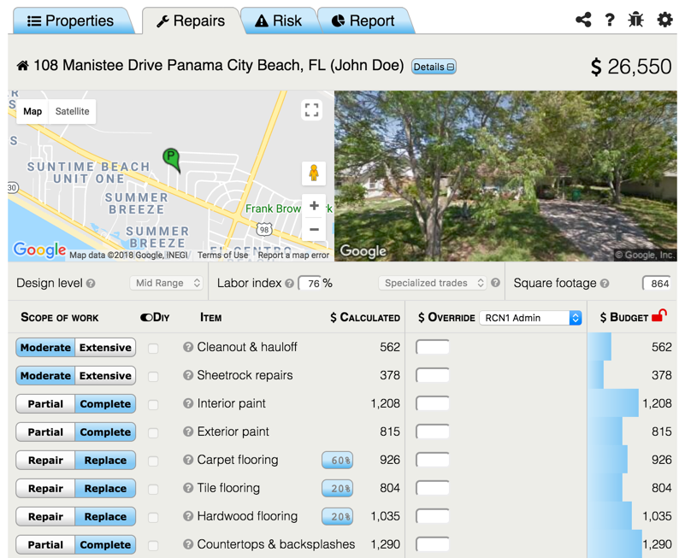
Managing Customer Records
Editing Customer Records
Clicking the Red Lock Icon at the top right corner of the Admin’s view will allow the Admin to Lock the customer record and permit only the Admin to make additional edits.
Notes:
Viewing Customer Records
Finding Customer Records (Searching and Filtering)
Editing (Locking & Unlocking)
Collaboration Scenarios (Adding and Selecting)
Sharing Records (Emailing & Texting)
Exporting to Excel

Slide 59
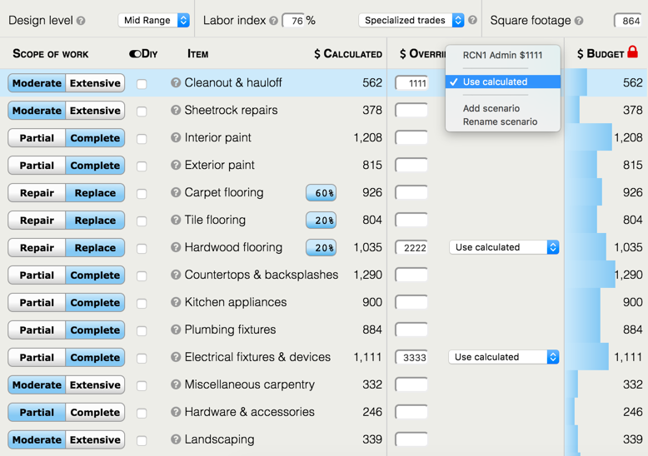
Managing Customer Records
Collaboration Scenarios
When an Admin enters an override value on a Customer record, that value becomes a selection option in the collaboration drop down list. Select the scenario value that you wish to use for your final budget.
Notes:
Viewing Customer Records
Finding Customer Records (Searching and Filtering)
Editing (Locking & Unlocking)
Collaboration Scenarios (Adding and Selecting)
Sharing Records (Emailing & Texting)
Exporting to Excel

Slide 60
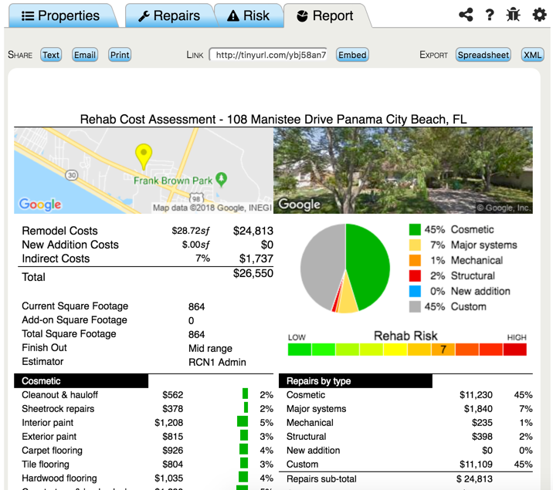
Managing Customer Records
Exporting to Excel
Click the ”Spreadsheet” button to initiate a CSV file download from your browser. You can save the file in CSV format or open it as a Microsoft Excel file.
Notes:
Viewing Customer Records
Finding Customer Records (Searching and Filtering)
Editing (Locking & Unlocking)
Collaboration Scenarios (Adding and Selecting)
Sharing Records (Emailing & Texting)
Exporting to Excel

Slide 61
RCN ACOUNT TYPES OVERVIEW
About the RCN / House Hacker Partnership
Due Diligence Tool for Single Family Residential Rehab Projects (Repairs & Risk)
Sales Pitch (Help customers do a better job of creating a Rehab Budget & Scope of Work)
RCN Branding
Landing Page URL (Unassigned Leads from Website)
RCN Account Types
Customer (Unlimited Users)
Admin (Loan Officers & Unassigned)
SuperAdmin
Coming Soon - Loan Originator Assistants
CREATING RECORDS
Setting up Customer Accounts
Sending your unique link to Customers
Customer account creation process
Starting a Record 3 Step Process
Address
Square Footage
Design Level
Property Settings Header (Repair Landing Page)
Design Level
Labor Index
Labor Type
Square Footage
Repair Tab - Page Navigation
Canned Scope of Work
Details Collapse
Tooltips
Apply for Financing
Save Button
Repair Cost Modifiers
Labor Type & Labor Index
Scope Intensity Selections
Override Fields
DIY Slider (Labor Only)
Using Selection Buttons (4 Main Types)
Flooring Selections
Adding Custom Scenarios
Calculated Rows (Add-on*, Fence, Patio)
Indirect Costs
APPLICATION NAVIGATION
Header Navigation - Toolbar
Sharing
Help
Bug Reports
Settings
Header Navigation - Tabs
Repairs
Risk
Report
Property Record Landing Page
Sorting
Searching
Mapping
Navigation Shortcuts
Printing the Walksheet
Property Status Types (Prospect, Closed, Funded, Inactive)
Deleting Properties
MANAGING CUSTOMER RECORDS
Finding & Viewing Customer Records
Editing Customer Records (Locking & Unlocking)
Collaboration Scenarios (Adding and Selecting)
Exporting to Excel

